Slide 1
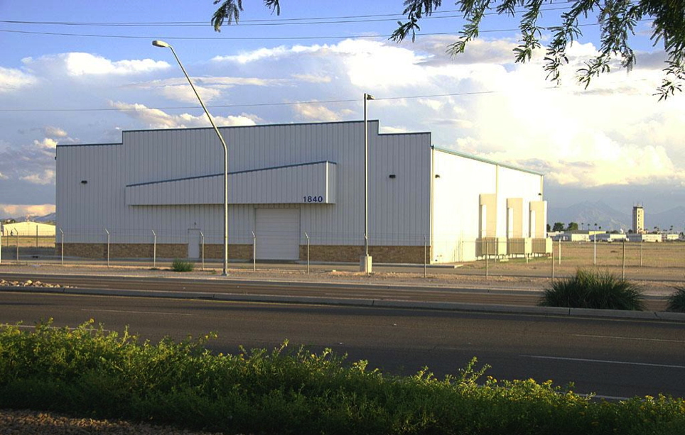
Real Air Hangar Before Million Air Facility Was Built

Slide 2
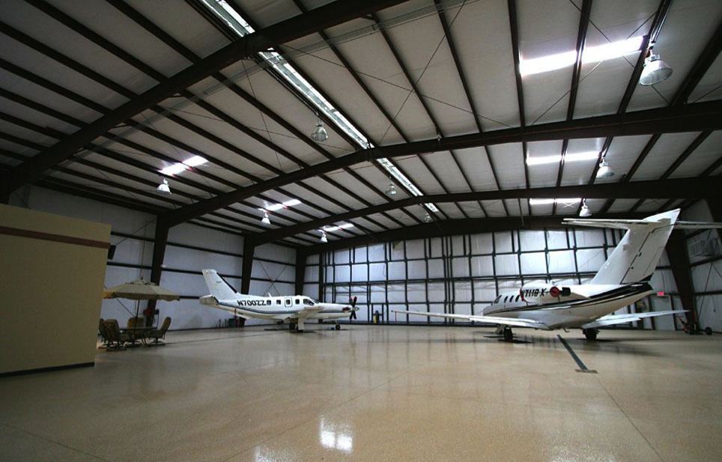
Main Hangar Space

Slide 3
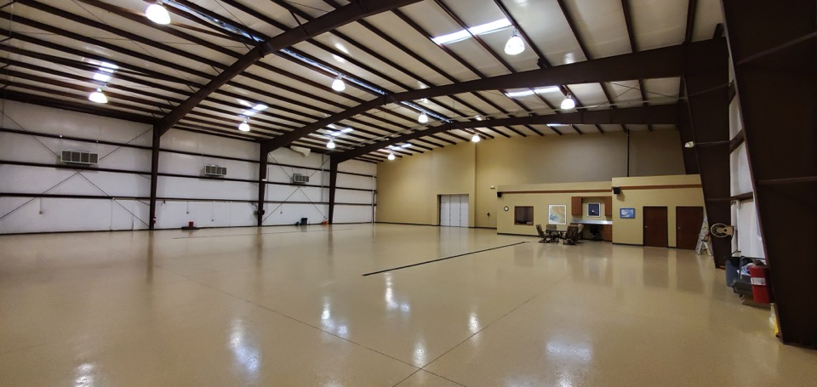
Main Hangar Space

Slide 4
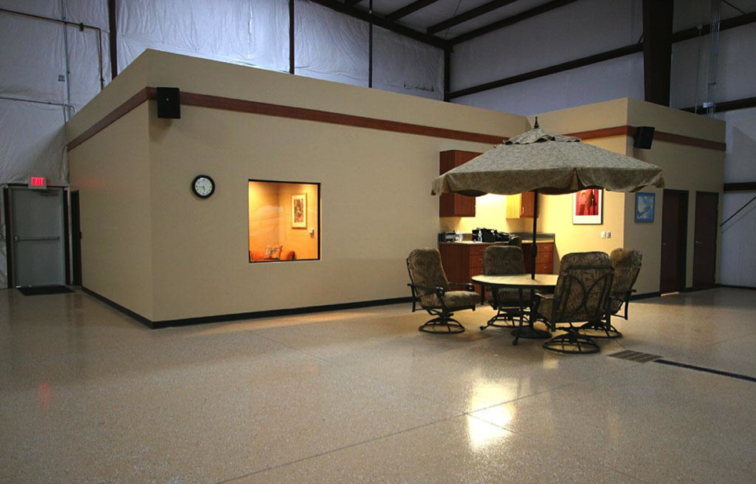

Slide 5
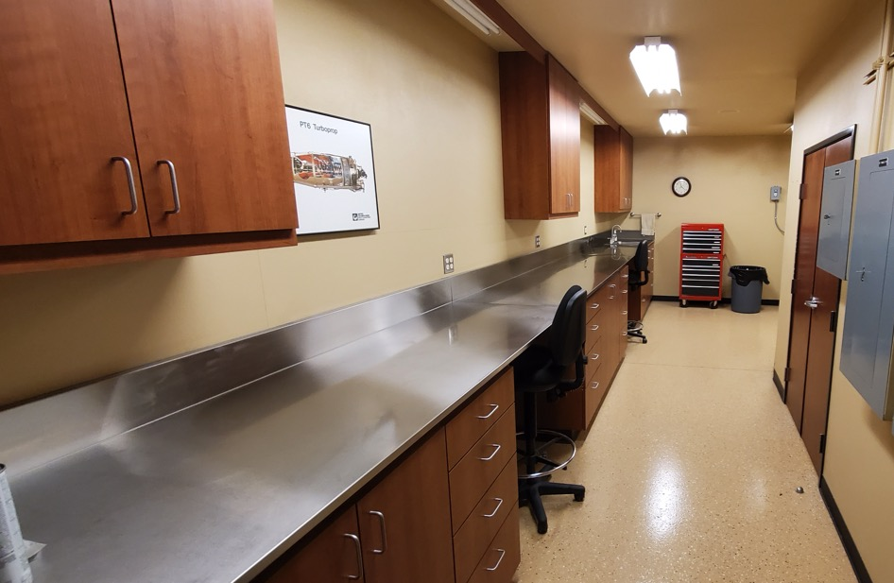
Workroom

Slide 6
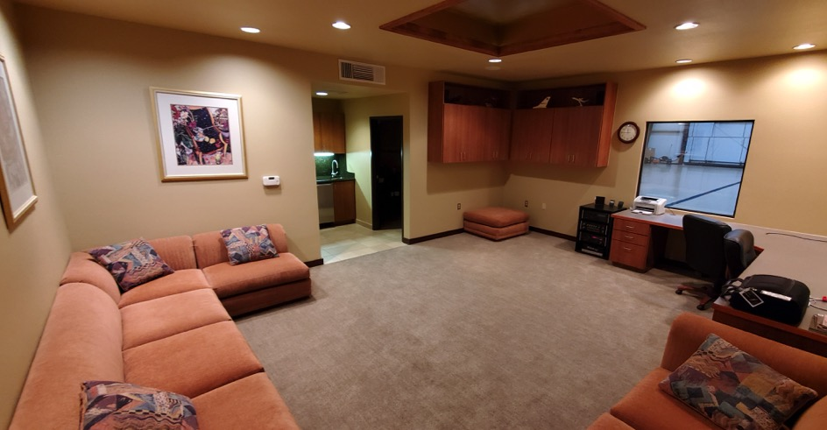
Office/Ready Room

Slide 7
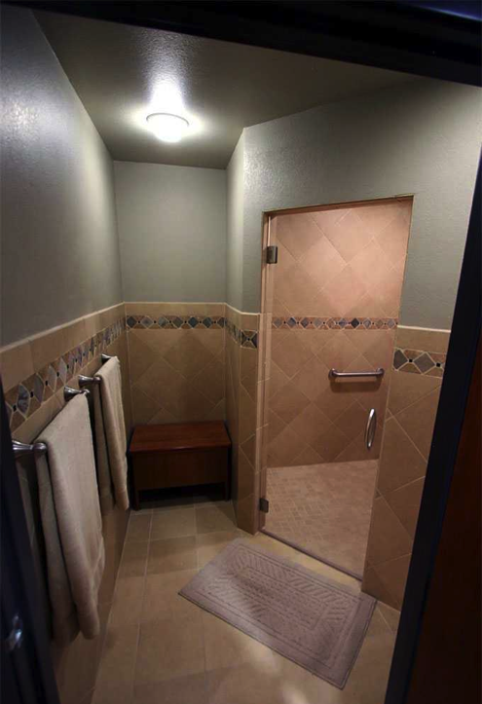
Shower Room

Slide 8
